Slide 1
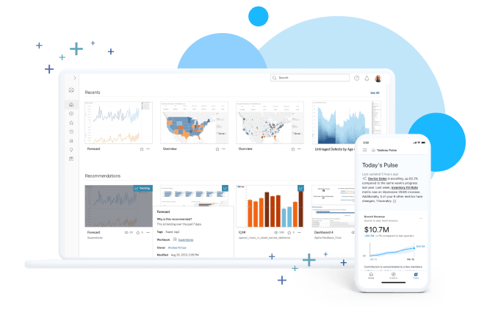
Data Analysis with Tableau
Unleashing the Power of Visualization

Slide 2
Introduction to Tableau
What is Tableau?
A powerful data visualization tool for business intelligence. Converts raw data into interactive and shareable dashboards.
Key Features:
Drag-and-drop interface
Connects to multiple data sources
Real-time collaboration
Advanced analytics capabilities

Slide 3
Benefits of Using Tableau
User-Friendly Interface
Handles Large Datasets
Real-Time Data Analysis
Cross-Platform Sharing
Extensive Visualization Options
Integration with AI and Machine Learning tools

Slide 4
Tableau Product Suite
Tableau Desktop:
For creating visualizations and dashboards.
Tableau Server: Sharing and collaboration platform.
Tableau Online: Cloud-based analytics.
Tableau Prep:
Data cleaning and preparation tool.
Tableau Public:
Free platform for public data sharing.

Slide 5
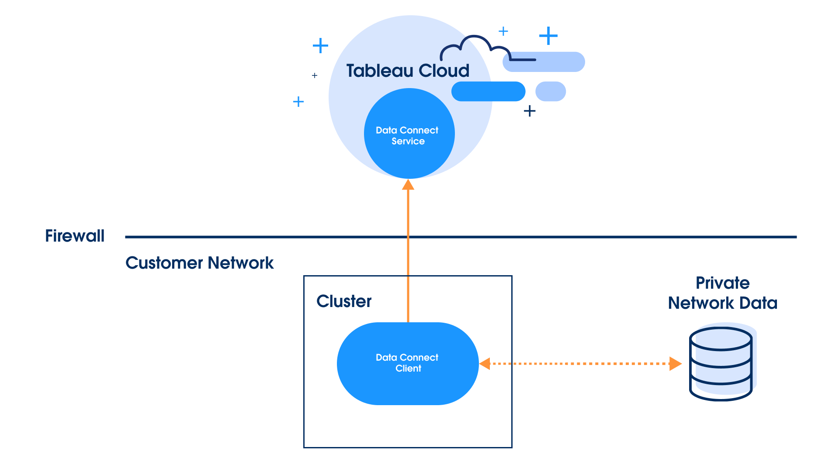
Connecting to Data in Tableau
Supported Data Sources:
Excel, CSV, JSON
SQL Databases (MySQL, PostgreSQL, etc.)
Cloud Services (AWS, Google BigQuery, etc.)

Slide 6
Tableau Interface Overview
Data Pane
Sheets and Dashboards
Toolbar and Menus
Show Me: Visualization Options
Marks Card: Customize Visualizations

Slide 7
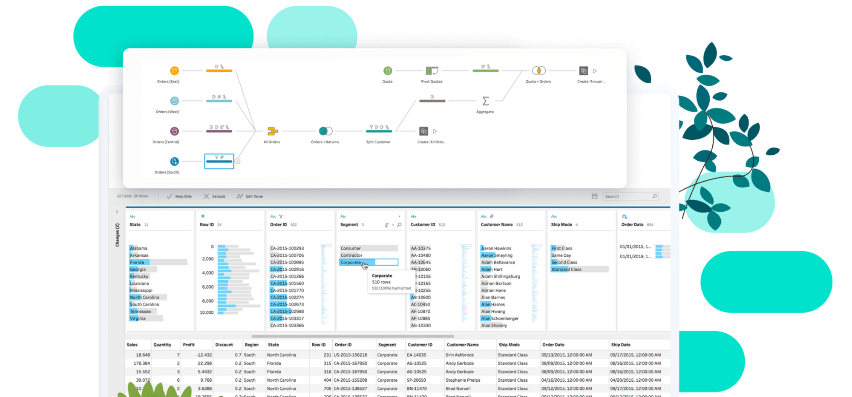
Data Preparation in Tableau
Data Cleaning with Tableau Prep:
Removing duplicates and null values
Changing data types
Merging datasets
Joins and Blends:
Inner, Outer, Left, and Right Joins
Blending data from different sources

Slide 8
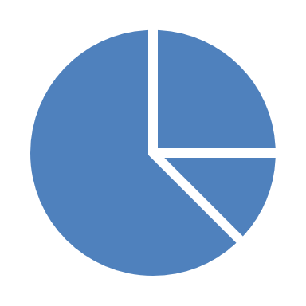
Creating Basic Visualizations
Common Chart Types:
Bar Charts
Line Charts
Pie Charts
Scatter Plots
Step-by-Step:
Drag dimensions and measures to Rows and Columns.
Use 'Show Me' to select a chart type.
Customize with Filters and Marks.

Slide 9
Advanced Visualizations
Heat Maps
Tree Maps
Bullet Graphs
Gantt Charts
Geospatial Maps
Example: Sales by Region
Requires geographic data fields.

Slide 10
Dashboards and Stories
Dashboards:
Combine multiple visualizations into one view.
Add interactivity with filters and actions.
Stories:
Present a sequence of visualizations to tell a data-driven story.
Example: A sales performance dashboard.

Slide 11
Publishing and Sharing
Methods:
Tableau Server
Tableau Online
Exporting as PDF, Image, or Packaged Workbook
Collaboration Features:
Commenting and live updates.
Embed visualizations into websites or applications.

Slide 12
Best Practices for Data Analysis with Tableau
Keep Visualizations Simple and Clear
Use Consistent Color Schemes
Leverage Filters and Interactivity
Ensure Data Quality Before Analysis
Use Dashboards to Combine Related Insights

Slide 13
Real-World Applications
Marketing Analytics
Sales Performance Tracking
Financial Analysis
Supply Chain Management
Customer Segmentation

Slide 14
Conclusion
Tableau simplifies data visualization and analysis.
Enhances decision-making through actionable insights.

